Slide 1
GLUG News
2023.10.25

Slide 2
COSMIC desktop updates
Recall COSMIC: DE from System76, used for PopOS!, written in Rust
New lock and login screen
Support for modifier-only key bindings
Per workspace tiling
Notes:
https://www.phoronix.com/news/System76-COSMIC-October
https://blog.system76.com/post/locked-and-loaded-with-new-cosmic-de-updates

Slide 3
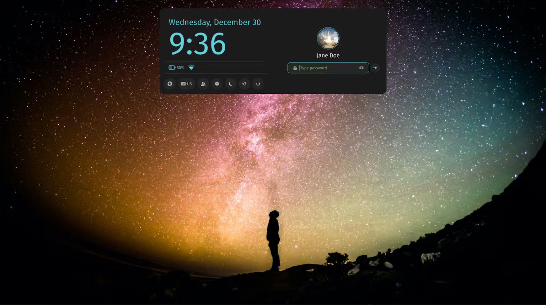
Notes:
https://www.phoronix.com/news/System76-COSMIC-October
https://blog.system76.com/post/locked-and-loaded-with-new-cosmic-de-updates

Slide 4

HTTP2 rapid reset attack
HTTP2 DDOS attack, ~398mil requests/s
Disclosed by Google/Cloudflare/AWS
Notes:
https://www.phoronix.com/news/HTTP2-Rapid-Reset-Attack
https://blog.cloudflare.com/zero-day-rapid-reset-http2-record-breaking-ddos-attack/
https://cloud.google.com/blog/products/identity-security/how-it-works-the-novel-http2-rapid-reset-ddos-attack

Slide 5

Raspberry Pi OS
Now based on Debian 12 Bookworm
Wayland instead of X11
  Using Wayfire as a compositor
PipeWire instead of PulseAudio
Raspberry Pi optimised Firefox
Notes:
https://www.phoronix.com/news/Raspberry-Pi-OS-Bookworm
https://www.raspberrypi.com/news/bookworm-the-new-version-of-raspberry-pi-os/

Slide 6

Ubuntu 23.10 Desktop ISOs recalled
User-submitted translations for installer contains hate-speech
“A community contributor submitted offensive Ukrainian translations to a public, third party online service that we use to provide language support for the Ubuntu Desktop installer.”
Fixed and back up now
Notes:
https://discourse.ubuntu.com/t/announcement-ubuntu-desktop-23-10-release-image-translation-incident-now-resolved/39365
https://www.phoronix.com/news/Ubuntu-23.10-Recalled
https://www.phoronix.com/news/Ubuntu-23.10-ISOs-Re-Released

